Slide 1


Slide 2
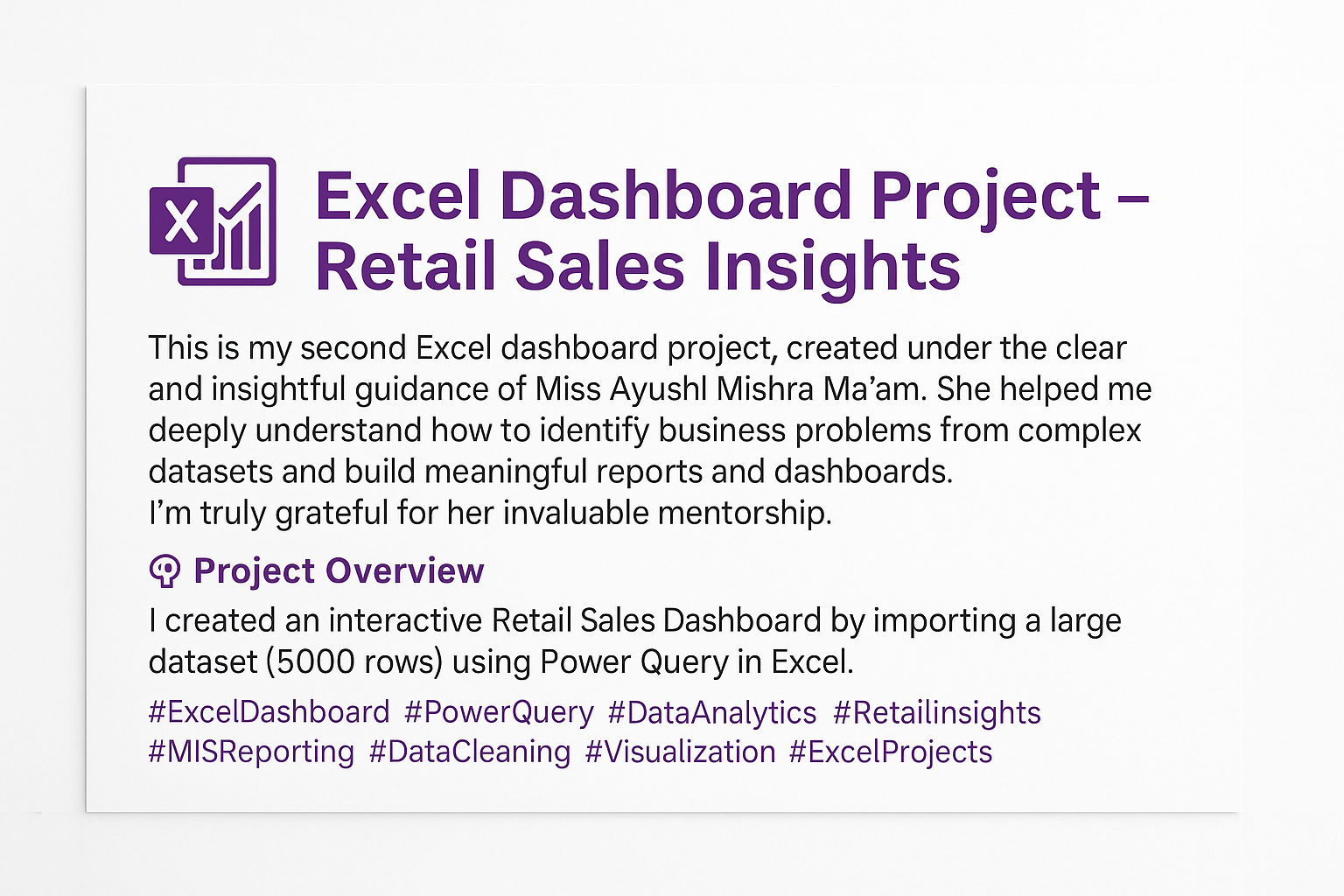

Slide 3
🔍 Excel Dashboard Project – Retail Sales Insights
Unlock the Power of Excel!

Slide 4
🧠 Project Overview
I created an interactive Retail Sales Dashboard by importing a large dataset (5000 rows) using Power Query in Excel. The goal was to solve real business problems using visual insights and pivot analysis.
📊 Tool Used: Excel (Power Query, Pivot Table, Map Chart)
📁 Data Source: 5000-row CSV file | Cleaned & Transformed in Power Query

Slide 5
❓ Business Problems Identified
Which category is driving sales the most?
How is profit changing over the years?
What are the monthly sales trends?
Who are the top 5 customers by profit?
Which states are contributing the most to sales?
What is the total customer count across years?
Final summary with dynamic filters (Category + Year)

Slide 6
⚙️ Steps Applied
Imported data via Power Query and applied cleaning steps.
Extracted Year and Month from Order Date.
Created separate Pivot Tables for each problem.
Used Slicers for interactive filters (Category & Year).
Built visualizations: Bar, Line, Pie, Map, Area Charts.
Designed a clean and color-themed Dashboard layout.

Slide 7
💡 Key Insights & Solutions
1. Sales by Category: Furniture leads in total sales, followed by Office Supplies and Technology.
2. Profit Gained Over Time: Highest profit observed in 2024, majorly driven by Technology.
3. Monthly Sales Trend: Sales peaked in October; lowest observed in April.
4. Top 5 Customers by Profit: Misha Chawla and Neysa Rege are top contributors.
5. Sales by State: Delhi and West Bengal dominate sales geographically.
6. Customer Count per Year: Steady growth in customer count, with a sharp rise in 2024.

Slide 8
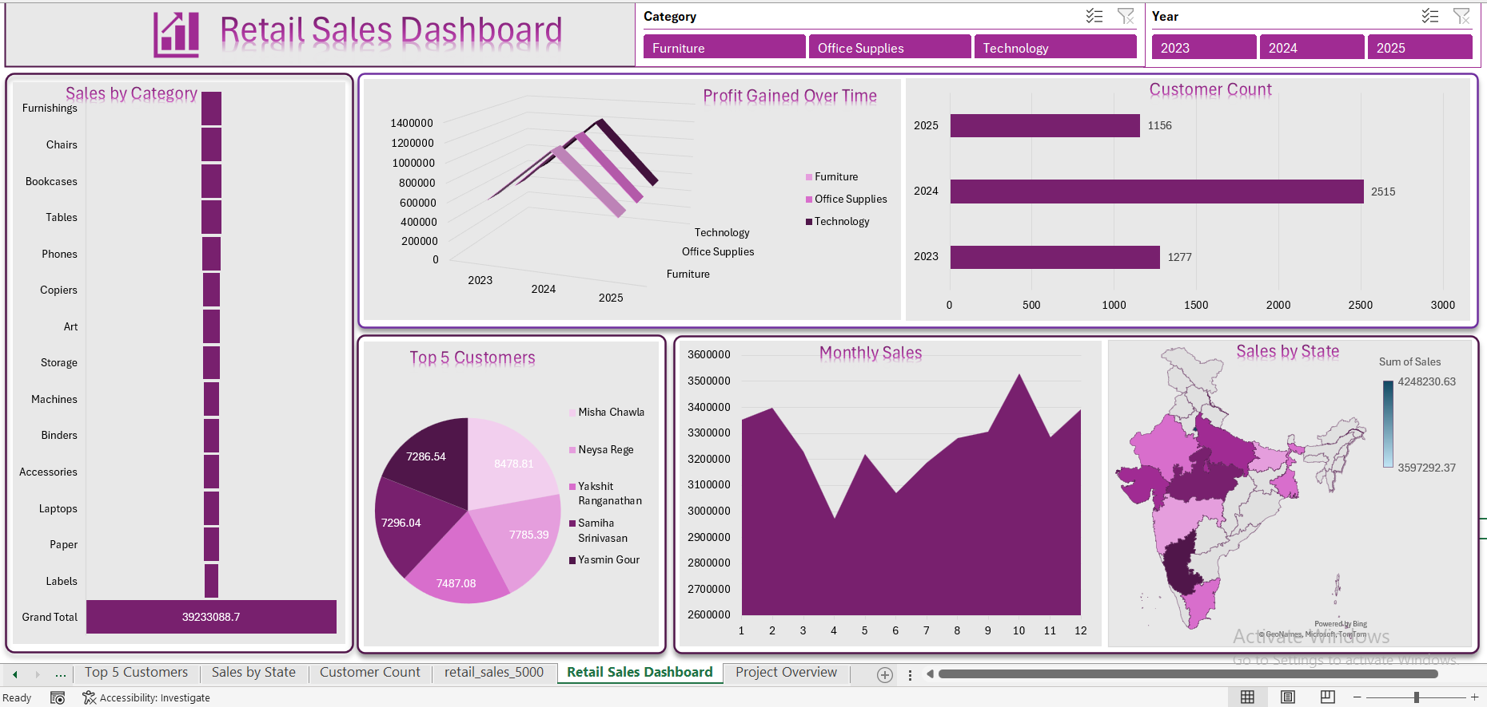

Slide 9
🌟 Dashboard Highlights
Fully dynamic and slicer-controlled dashboard
Covers multi-angle insights: category, time, geography, customer
Designed for clarity, actionability, and user interaction
Built 100% in Excel – no add-ins, just skills!

Slide 10
📌 Conclusion
This project was a true turning point in my Excel journey — where I moved beyond formulas to solving real-world business problems.
It sharpened my ability to:
Transform and model data using Power Query
Extract insights with purpose-driven pivot analysis
Design dashboards that tell stories, not just show numbers
Think critically from a business decision-maker’s perspective

Slide 11
📌 Conclusion
More than just a technical task, this dashboard taught me how to connect data with decision-making — and how a tool as simple as Excel can be turned into a strategic advantage when used with clarity, intent, and creativity.

